Slide 1
Estimating the
Predictive Accuracy of a Classifier
Course Code: CSC 4139
Course Title: Data Warehouse and Data Mining
Dept. of Computer Science
Faculty of Science and Technology
Lecturer No: | 11 & 12 | Week No: | 6 | Semester: | Summer
Lecturer: | Tohedul Islam, islamtohedul@aiub.edu

Slide 2
Lecture Outline
Quiz - 2
Estimate the Predictive Accuracy of a Classifier
Experimental Results - I
Experimental Results - II: Datasets with Missing Value
Confusion Matrix
Explore WEKA Tool
Review Lecture of Mid-term Syllabus

Slide 3
Estimating the
Predictive Accuracy of a Classifier
Lecture Objectives and Outcomes:
  This lecture explores the methods of estimating the performance of a classifier.
  Three methods are described for estimating a classifier’s predictive accuracy. The first of these is to divide the data available into a training set used for generating the classifier and a test set used for evaluating its performance.
  The other methods are k-fold cross-validation and its extreme form N-fold (or leave-one-out) cross-validation.

Slide 4
Estimating the
Predictive Accuracy of a Classifier
Lecture Objectives and Outcomes:
  A statistical measure of the accuracy of an estimate formed using any of these methods, known as standard error is introduced.
  A tabular way of presenting classifier performance information called a confusion matrix is introduced
  Apply WEKA Tool for solving different Data Mining tasks
  Review Mid-term Syllabus

Slide 5
Quiz - 2

Slide 6
Estimating the
Predictive Accuracy of a Classifier

Slide 7
Introduction
Any algorithm which assigns a classification to unseen instances is called a classifier.
Predictive accuracy -> The proportion of a set of unseen instances that it correctly classifies.
Other criteria are also important, such as algorithmic complexity.

Slide 8
Introduction
Three main strategies (training/test):
  Dividing the data into training and test set
  K-fold cross validation
  N-fold (leave one out)cross validation

Slide 9
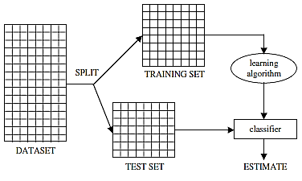
Method 1: Separate Training and Test Sets
Data is split into two parts called a training set and a test set
Training set is used to construct a classifier
The classifier is then used to predict the classification for the instances in the test set.
If the test set contains N instances of which C are correctly classified, C are correctly classified
Predictive accuracy, P = C/N

Slide 10
Standard Error
Predictive accuracy (estimate of the true predictive accuracy) is calculated from sample data
True predictive accuracy could be calculated if we can use ALL unseen data
  Which is impossible
We can use statistical method to find a range of values within which the true value of the predictive accuracy lies with a specific probability of “confidence level”
So how can we predict/range of the true predictive accuracy?

Slide 11

Standard Error
Using statistical methods to find a range of values within which the true value of the predictive accuracy lies, with a given probability or ‘confidence level’.
To do this we use the standard error associated with the estimated value p

Slide 12

Standard Error
Confidence Level (CL)
Standard Error (Z_{CL})
The true predictive accuracy lies in the interval :
If N=100, and C=80, so P=80/100=0.8
Standard Error =
Now we can say with probability 0.95 (confidence level) the true predictive accuracy lies in the interval 0.8 ± 1.96 × 0.04 i.e. between 0.7216 and 0.8784.

Slide 13

Standard Error
  The predictive accuracy of a classifier is often quoted as in technical papers as just without any multiplier ZCL.
  So 0.8 ± 0.04

Slide 14

Repeated Train and Test
Repeat k times:
  K : test sets
  N : samples at each trial/test
  P: average accuracy
If test sets are not all same size:
  If there are N_{i} instances in the ith test set (1 ≤ i ≤ k) and the predictive accuracy calculated for the ith test set is P_{i}
  The overall predictive accuracy p is:
  P is weighted average of P_{i}

Slide 15
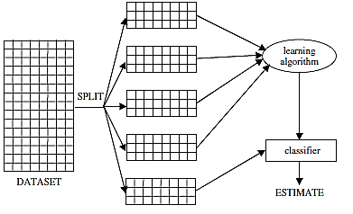
K-fold Cross Validation
Dataset comprises N instances
Divided into k equal parts, k typically being a small number such as 5 or 10. (If N is not exactly divisible by k, the final part will have fewer instances than the other k − 1 parts.)
Each of the k parts in turn is used as a test set and the other k − 1 parts are used as a training set.
Selection bias is minimized
Usually K = 5 to 10

Slide 16
N-fold Cross Validation
N-fold cross-validation is an extreme case of k-fold cross-validation
Often known as ‘leave-one-out’ cross-validation or jack-knifing
Dataset is divided into as many parts as there are instances, each instance effectively forming a test set of one.
K=N
e_{1,} e_{1,}…….,e_{n}
Take the average.
High computation is required, but validation way is nice

Slide 17
Experimental Results - I
Predictive accuracy of classifiers generated for four datasets.
All the results in this section were obtained using the TDIDT tree induction algorithm, with information gain used for attribute selection.
More detail on the datasets in the course book, in Appendix B

Slide 18
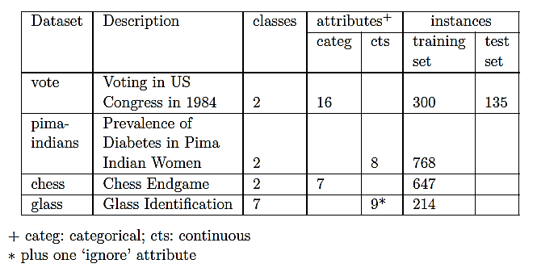
Experimental Results - I

Slide 19
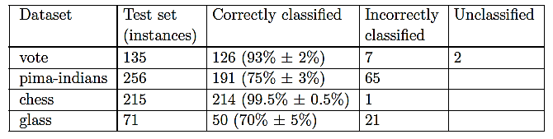
Experimental Results - I

Slide 20
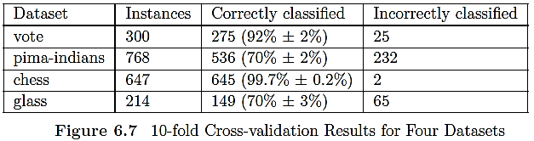
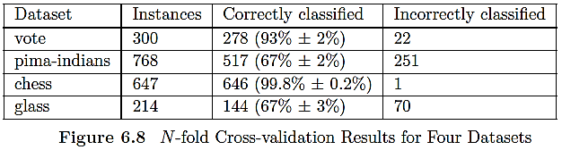
Experimental Results - I
Below results obtained using 10-fold and N-fold Cross-validation for the four datasets.

Slide 21
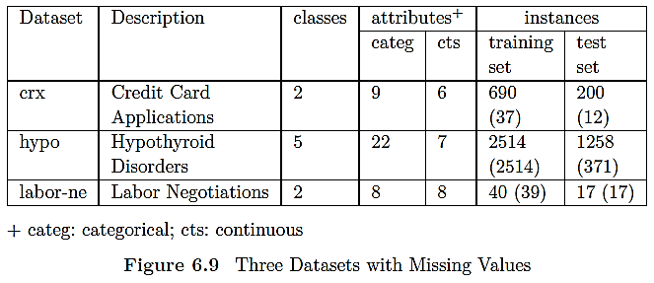
Experimental Results - II:
Datasets with Missing Value
Experiments to estimate the predictive accuracy of a classifier in the case of datasets with missing values.
All the classifiers using the TDIDT algorithm, with Information Gain for attribute selection.

Slide 22
Experimental Results - II:
Datasets with Missing Value
How to deal with missing values?
Two strategies for dealing with missing attribute values were described
  Discard Instances
  Replace by most frequent/average value

Slide 23
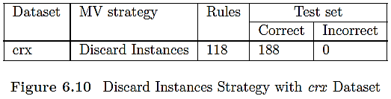
Discard Instances
Discarding data may damage reliability of the resulting classifier
What if the proportion of missing values are large?

Slide 24
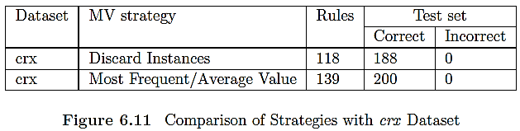
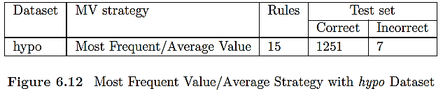
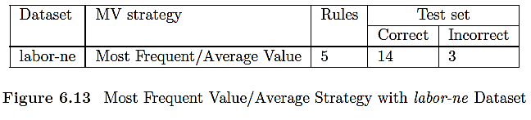
Replace by Most Frequent/Average Value

Slide 25
Missing Classification
How to deal with missing classification?
  Replace by most frequent class?
  Discard the instance?

Slide 26
Confusion Matrix
As well as the overall predictive accuracy on unseen instances it is often helpful to see a breakdown of the classifier’s performance, i.e. how frequently instances of class X were correctly classified as class X or misclassified as some other class.
This information is given in a confusion matrix.

Slide 27

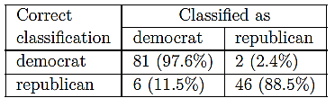
Confusion Matrix

Slide 28
Explore WEKA Tool
Apply WEKA tool for solving different data mining tasks, such as, KNN, Decision Tree, etc.

Slide 29
Review Lecture of
Mid-term Syllabus
Data for Data Mining
Classification, Naïve Bayes and KNN
Decision Tree
Predictive Accuracy of a Classifier
WEKA Tool

Slide 30
Lecture Reference
Principles of Data Mining – Max Bramer (2nd Edition)
  Chapter – 6 (Estimating the Predictive Accuracy of a Classifier)
https://www.statisticshowto.datasciencecentral.com/what-is-the-standard-error-of-a-sample/
Weka - open source machine learning software
  https://www.cs.waikato.ac.nz/ml/weka/

Slide 31
References
Principles of Data Mining – Max Bramer (2nd Edition)
Data Mininig Concepts and Techniques – Jiawei Han, Michaline Kamber, Jian Pei, 3rd Ed.
Weka - open source machine learning software
  https://www.cs.waikato.ac.nz/ml/weka/
The UCI Repository of Datasets
  https://archive.ics.uci.edu/ml/index.php
Kaggle: Your Machine Learning and Data Science Community
  https://www.kaggle.com/

